Slide 1

Controller type selection

Slide 2


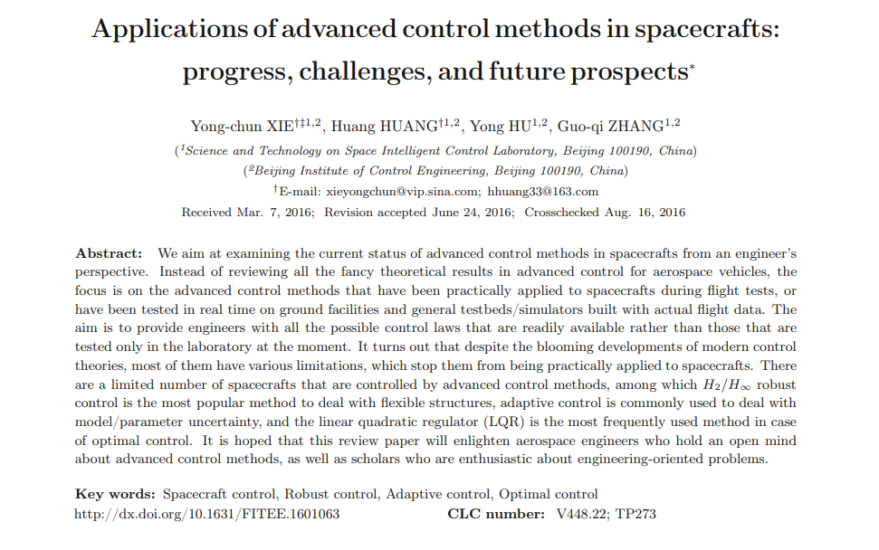
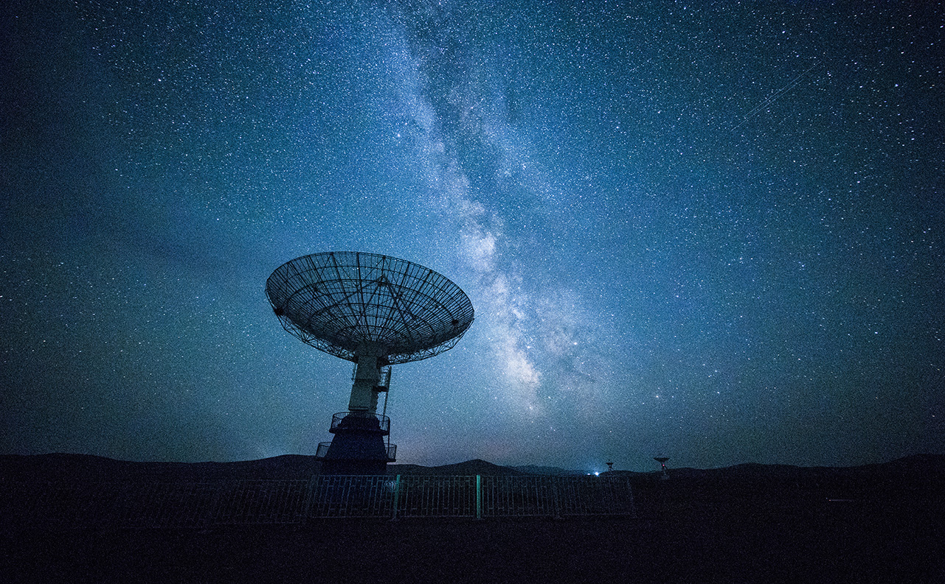
Types of control
Optimal Control
Adaptive Control
Robust Control
https://link.springer.com/content/pdf/10.1631/FITEE.1601063.pdf

Slide 3
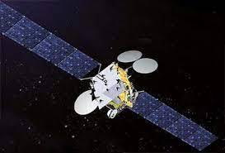
H∞ vs PID
Improved stability margins
Stronger robustness
Better dynamic performance
Less fuel consumption
Engineer-friendly design process
Spacebus 4000

Slide 4
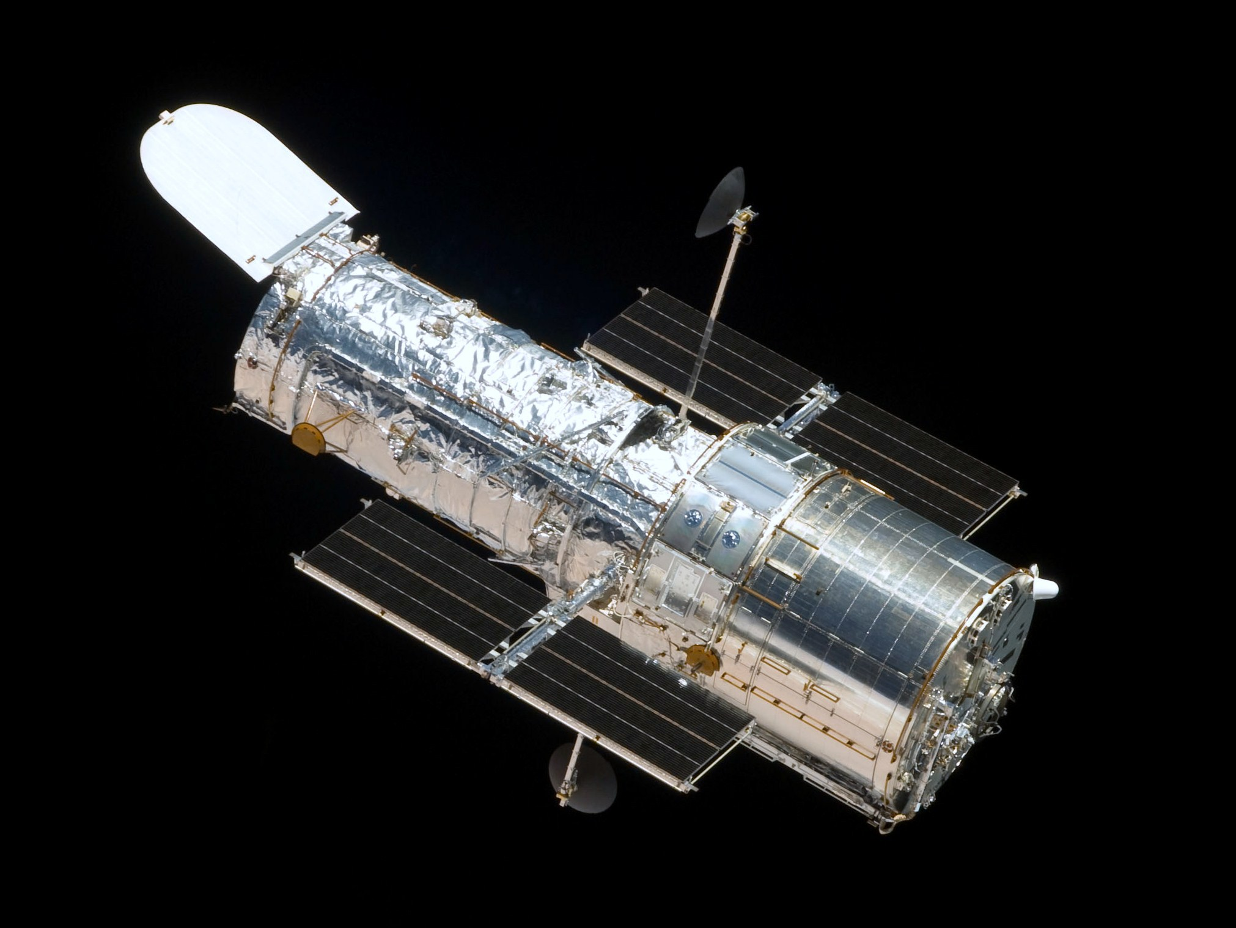
Hubble space telescope
Issue:
Thermally induced deformations of solar arrays
Large perturbations
Underperforming PID controller
Controllers tested instead:
H∞
LQG (linear quadratic Gaussian)
Hubble Space Telescope

Slide 5
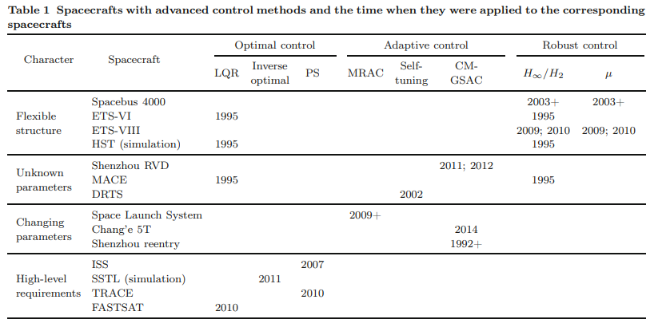
Advanced control methods used

